Slide 1



Variant Calling (using High-throughput Sequencing Data)
October 2015

Slide 2
About the course

Slide 3

INF-BIOX121
The tough challenges:
High Throughput Sequencing
Biological Applications
Informatics
What is the secret for 18 hours with me
to be fun for you?
to be fun for me?
you to learn as much as possible?
An attitude that works well in all walks of life
take initiative for problem solving
then ask for help

Slide 4
Who is teaching?
People
Tim – bioinformatics – HTS since 2009
Even and Srinidhi – both took the course last year
What we know about HTS
I have run this course many times
its going not going to be easy
its probably going to be messy
but you will go away having learnt a lot, we hope ☺

Slide 5
Our goal for the participants
Finish the course with an understanding of all major concepts
Know how to run a variant calling pipeline
Ready to make informed choice about whether you may need a simpler or more complex pipeline
Focus is on Variant Calling and functional annotation
Previous courses have expressed need for more downstream analysis
So we have included more of this
You might experience some overlap with other modules of the course, but repetition can be beneficial

Slide 6
Themes running across the different modules
Technical / bioinformatic
Study design
Mapping principles
Alignment principles
Alternative splicing
Model system vs non-model system organisms
The bioinformatic “process”
Reproducibility
Best practices
Testing
Documenting
Statistics and hypothesis testing
Summary statistics and visualisation
Sanity checking / validation of results
Finding data and munging it incl. public databases

Slide 7


Slide 8


Biologist advice to a biologist
1st advice: DON'T PANIC 2nd advice: DON'T PANIC 3rd advice: DON’T
Do the unix part of tutorial of Unix and perl primer for biologists: http://korflab.ucdavis.edu/Unix_and_Perl/ , alternatively:
http://linuxcommand.org/learning_the_shell.php#contents
http://www.tuxfiles.org/linuxhelp/cli.html
Yyou are not the first to have problems
search for it on the net
or, if you can’t find the answer, ask in a forum
Learn to write a very simple script
Make a list of your favourite commands as you learn them.
Often when something is difficult to understand it is often either because:
It is not clear what is being done
Or because it is not clear why it should be done
So stop me and ask if the WHAT or the WHY is unclear!!!

Slide 9
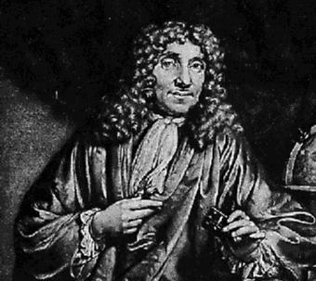
Some thoughts about scientific problems vs. techniques
Always keep in mind what the basic goal is and what the basic issues are with attaining that goal.
Learn to switch from the broad picture to the details and back again.
In my opinion it is mistake to focus too much on specific techniques. Become good at different techniques, but learn them because they help you solve problems.
Don't go looking for things you can apply a technique to or at least be careful to not do only this.
Antony van Leeuwenhoek is a good counter-example
An exception to not focussing on techniques
Antony van Leeuwenhoek (1632-1723)

Slide 10

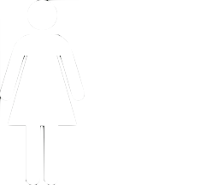
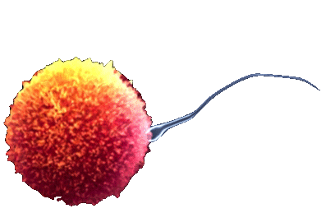
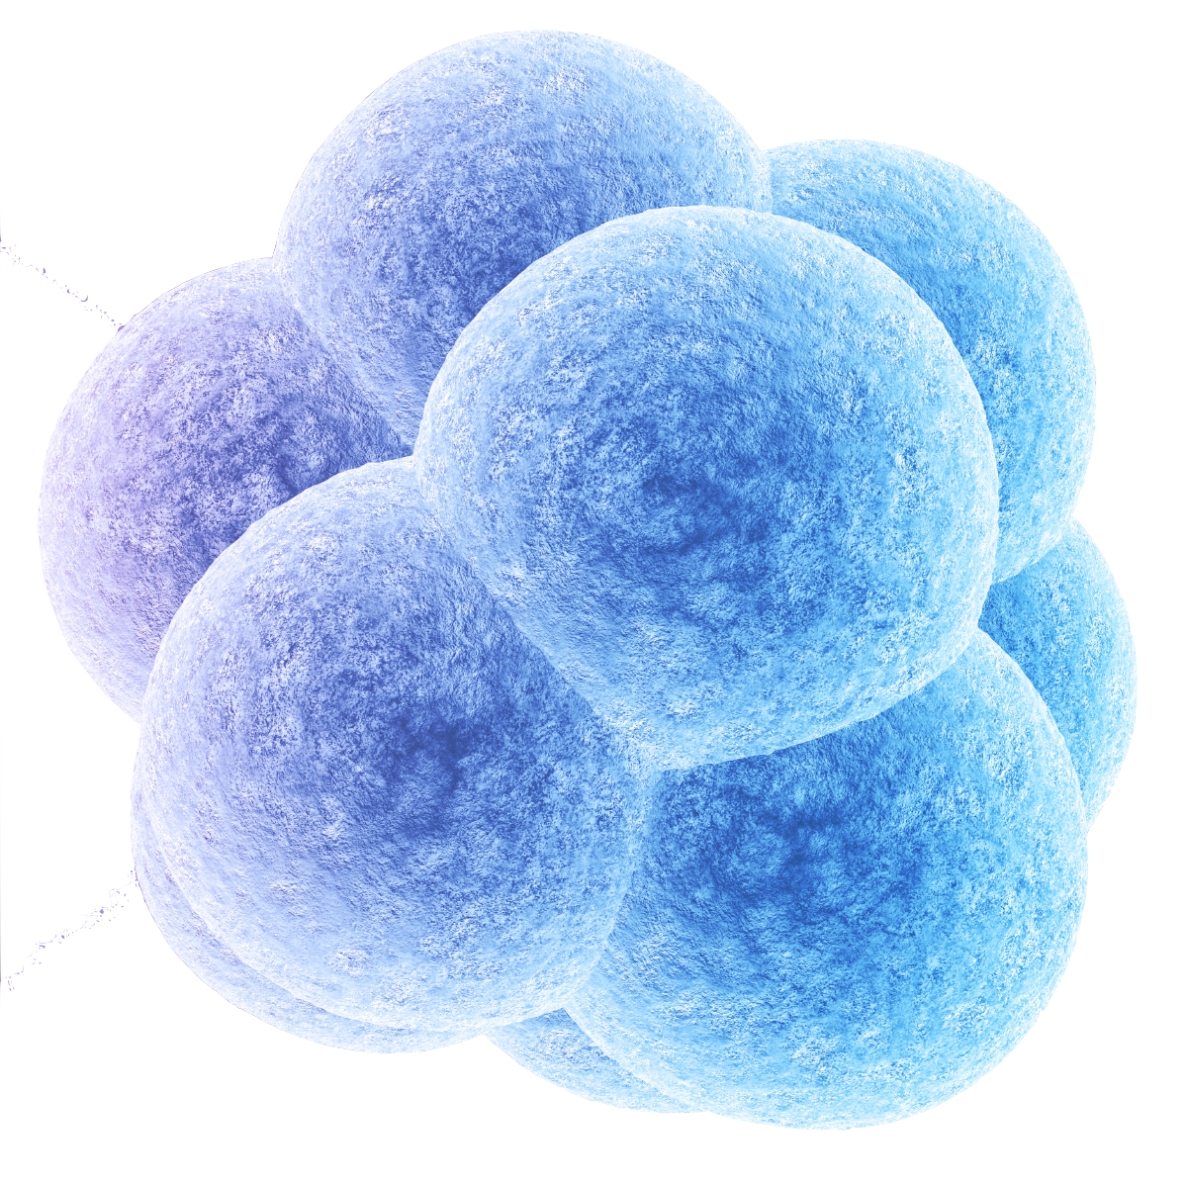
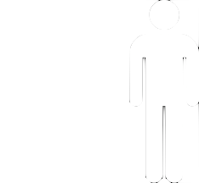
Humans and other multicellular organisms
A reproducing system which is:
* Self-assembling
* Self-repairing
* Self-operating
* Self-upgrading
* Self-aware
* Social and spiritual
The full information underlying this system is stored in the DNA of EVERY cell

Slide 11
So why variant calling?
To known the DNA sequence
Why is the DNA sequence of interest?
Because it is the genetic blueprint, driving a large fraction of the higher level phenotypes (protein, network, cell, organ, behaviour, disease)
Because it is product of evolution and thus contains information:
about the evolutionary process
about the populations which have evolved

Slide 12
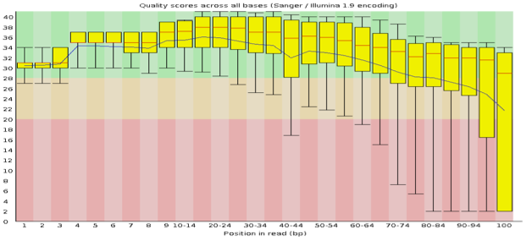
In a perfect world – Perfect sequencing
Perfect sequencing:
single molecule (no PCR)
full length
no deterioration of quality
The real world has improved but is not perfect:
Sanger
PCR
length: some kb
limited number of reads
high quality
HTS (Illumina)
PCR
100-300 bp
Paired-end option (PE)
billions of reads
high quality, but deteriorating along read
full length read
CTATGCATAATTTAAAGCTAATTTATCGGCCC
read
chr
CTATGCATAATTTAAAGCTAATTTATCGGCCC
249 Mbp
800 bp
read
few kbp
amplicon
100 bp
100 bp
read
300 bp
frag

Slide 13
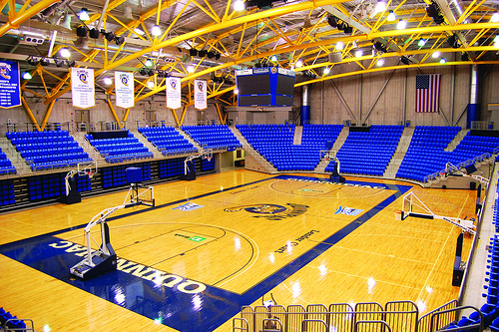
Looking for a ping pong ball in a stadium
With a hand torch!!
Or with the lights on?

Slide 14
A quick overview of the HTS workflow
Fragment sample
sample frags
sample
bait
ref
Capture
Sequence
Map
ref
pileup
Align
99% of sites are NOT variant, but it is the variant sites that are interesting
T
T
T
Variant call
C
C
C
C
Reference

Slide 15
Variant sites
pileup
T
The common and easy case
Good mapping of reads
Good base qualities
Good depth
T
T
6 aligned reads
C
C
C
C
Reference
pileup
T
Poor depth
May not have sampled both alleles
Could be C/T or T/T
T
T
C
pileup
T
Poor quality
Poor quality
of base calls
of read mapping
Can lead to false variant calls: site could be ref C/C and Ts are just base call errors
T
T
C
C
C
C

Slide 16
Our pedagogical approach
FASTQ
SAM
Sorted BAM
VCF file
Mapping (BWA)
HouseKeeping (picard)
Variant calling (gatk)
Multiple iterations with increasing complexity
HouseKeeping (picard)
FASTQ
SAM
Refined BAM
VCF file
Mapping (BWA)
Variant calling (gatk)
Refinements (gatk)
Coverage metrics
Filtration and annotation
Alignment metrics
Insert metrics
Duplicationmetrics

Slide 17
What do we aim to achieve with this approach
Hoped for advantages of approach:
simple to understand most basic pipeline and easy to run
practice in each iteration
Don’t worry if you do not understand everything at the first iteration
With bioinformatic pipelines it is generally a good idea to quickly create a simple version before make it more complex
prototyping
Check out Tom Wujec’s TED talk “The marshmellow challenge”
We will focus on single sample analysis, and will discuss more complicated setups later
multi-sample
pooled

Slide 18
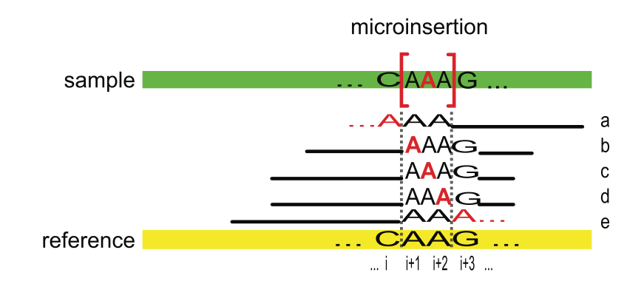
Why do we need a “complex” pipeline?
The biggest problem with variant calling is large numbers of FPs and FNs:
Mainly driven by bad alignments
FNs often create FPs
Can be systematic across samples, thus creating consistent SNPs across samples that are just machine artifacts.
FPs and FNs, may result in:
the signal in our data drowning in noise ➔ no result
false results ➔ erroneous result
You may find that reviewers will object to a pipeline which is not state-of-the-art, which creates trouble for you in the review process eventhough you may actually have a result.

Slide 19
Choice of example dataset
Human data – arbitrary
What if you work on other species?
if you have a reference genome and reads from a sample you can run the most basic pipelines
For more advanced pipeline you may have to spend some effort finding or generating auxiliary files in correct format
dbSNP
Genome annotation
You may find that they are already available for many species
Check out the GSA/GATK website
Check out http://getsatisfaction.com/gsa

Slide 20
GSA team at the Broad Institute
A large fraction of the materials and software in this course are produced by the Genome Sequencing and Analysis Group team at the Broad Institute
Information sources
http://www.broadinstitute.org/gsa/wiki
http://www.getsatisfaction.com/gsa
People
Mark A. DePristo, Manager of Medical and Population Genetics Analysis
Eric Banks, Team Lead
Guillermo del Angel
Ryan Poplin
Kiran Garimella, Team Lead
Mauricio Carneiro
Chris Hartl
Khalid Shakir, Team Lead
Matthew Hanna
David Roazen
Others at the Broad
Heng Li: samtools and bwa
Tim Fennell: picard
Alec Wysoker: picard
Brac Chapman: bcbio.variation
And others outside the Broad
sources at bottom of slides

Slide 21
For each practical
Most key concepts explained up front
sometimes concepts will be first introduced in the practical (this will be the exception)
Run through of the practical in plenum
Read carefully through the practicals. All the information you need for doing the practical should be in the file
Practical session
Try to get it running
If fail or computation takes time ➔ go to exercisesResults directory
You will be doing “copy and paste”
that is OK
but you must understand what you are copying and pasting
if you don’t ask for explanations
Use of labels to indicate status: “finished” and “needing help”
It is hard!
new concepts
new environment (Unix)
try to understand both and take notes!

Slide 22
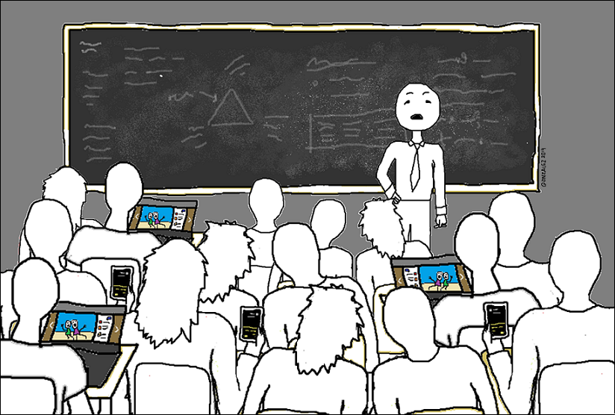
I would rather you focus on working on the course
If you cannot, do not disrupt me or fellow students:
silent phones
no youtubing or videos
no chatting
no knitting
Alternatively, you can leave

Slide 23
Other dos and donts
Do
Sign the attendance sheet
Remember that there are wide differences in competance
Consolidate your knowledge if you get ahead
Talk and get help from your neighbours
Do not ask questions in plenum if you get ahead, instead consolidate what you have learnt (tool websites)

Slide 24

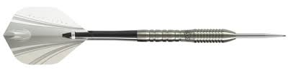
Unix attitude
Get used to having to know where you are and to tell the computer where things are
Be as precise as you are in your field
Pay attention to detail and changes
String commands together if you can
java -Xmx2G -jar ${swDir}/picard-tools-1.67/MarkDuplicates.jar \
INPUT=aln.posiSrt.clean.bam \
OUTPUT=aln.posiSrt.clean.dedup.bam \
METRICS_FILE=aln.posiSrt.clean.dedup.bam_metrics.duplication.txt
../vc/exerSandbox/03_advancedPipeline
-rw-rw-r-- 1 timothyh timothyh 26M Oct 2 14:30 aln.posiSrt.clean.dedup.bam
-rw-rw-r-- 1 timothyh timothyh 145K Oct 2 14:30 aln.posiSrt.clean.dedup.bai
cat ${dataDir}/reads_agilentV1_chr5/simul_indels/deletions.vcf | grep -v "^#" | wc -l

Slide 25
Some useful unix shortcuts
Ctrl + a: go to beginning of line
Ctrl + e: go to end of line
Ctrl + k: remove text after pointer
Ctrl + u: remove text before pointer
Arrow up and down to scroll through history
Ctrl + r: reverse search history

Slide 26
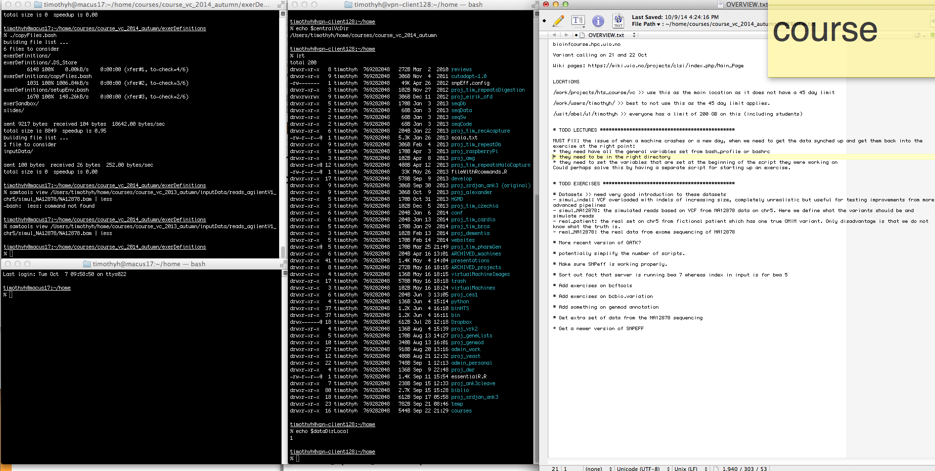
Organising your desktop
Keep an electronic notepad of file paths
Useful to have multiple terminals

Slide 27
software and dataset – setup and introduction

Slide 28
Software and data installation – mini practical
Use the terminal or a file explorer to take a look at the central repository
exerDefinitions contains all the practicals
exerResults contains pre-computed results of practicals
inputData contains all the datasets we will be working on
Software
for documentation of how the tools work for a lot of commands you get a quick help by typing the following at the command line: command or command –h
If this does not work, the best is to google the tool and read the online documentation.
Lets take a quick look at the data >> mini practical (see next slide)

Slide 29
Introduction of datasets in inputData
reads_exomeCapt_chr5 in fastq format (reads_agilentV1_chr5)
real reads from exome capture (real_patient)
simulated: known mutations (mainly indels) and simulated reads (simul_indels) – same regions as real dataset
simulated: known mutations (mainly indels) and simulated reads (simul_NA12878) – same regions as real dataset
reference data (human_g1k_v37_chr5)
agilentV1 >> definition of capture tiles in different formats
gatkBundle >> reference data in fasta format and vcf files of known variants (dbSNP, 1000 genomes, hapmap)
Formats >> we will return to these later

Slide 30
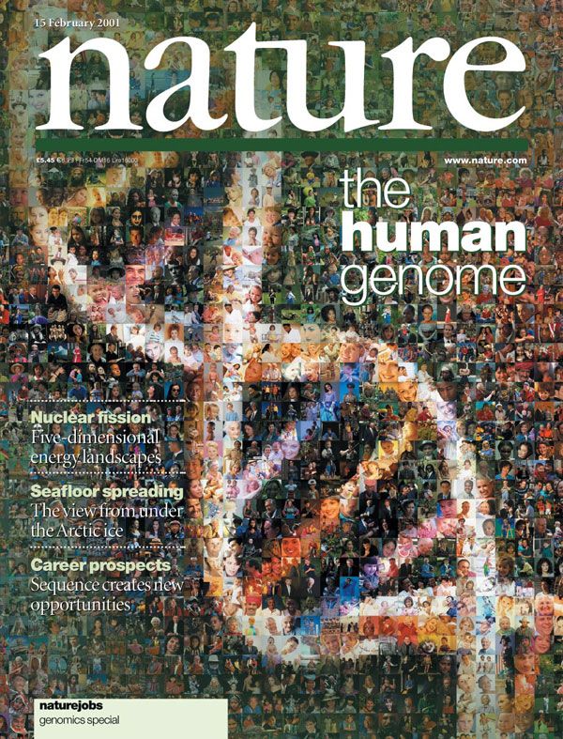
The reference genome
Or the species of your choice.
Some kind of reference is necessary for variant calling.
It is possible to use closely related species as a reference.

Slide 31
Naming and ordering of chromosome/contigs
 | Hg18 (UCSC) | B36 (NCBI)
Contig prefix | chr | none
Mitochondrial contig | chrM | MT
Contig order | chrM, chr1, chr2, ....., chrX, chrY | 1, 2, ...., X, Y, MT
Genome references
Fasta file: must have .fasta extension + respect naming and order
Fai file (created by samtools faidx): contig, size, location, basesPerLine ➔ for efficient random access
Dict file (created by Picard CreateSequenceDictionary): SAM style header describing the contents of the fasta file ➔ for names and length of original file
ROD (reference ordered data)
GATK supports several common file formats for reading ROD data: VCF, UCSC formatted dbSNP, BED
dbSNP files
Must also be ROD
Generated by GSA from the dbSNP db using a bit of bash, awk and a perl script: sortByRef.pl. Full details: http://www.broadinstitute.org/gsa/wiki/index.php/The_DBSNP_rod
All of the above delivered for human as part of the GATK resource bundle
Other species may also be available
Help on generating for another species see GATK wiki or getsatisfaction.com/gsa

Slide 32
The FASTQ reads: Motivating the simulation
Why simulate in variant calling?
with real data we do not know the “truth”
in a simulation, we can define the “truth” and then “hide” it and test how well our methods can recover this “truth”
in a real dataset, most variants are single nucleotide polymorphisms and these are usually very easy to correctly call
Drawbacks of simulation: usually will not accurately model all aspects of real data

Slide 33
The simulation
Fragment sample
sample frags
sample
bait
ref
Capture
Sequence
Map
Align
ref
Are we able to correctly call this site as variant?
Variant call
Potential challenges are:
depth of coverage
position in read
size of indel

Slide 34
The simulated dataset
Placed in true agilent tiles on chr 5
SNPs – 100 of each type >> 600 in total
3 strands (1 hetero, 2 hetero, 3 homo)
2 positions in tile
Deletions – 5 of each type >> 1800 in total
3 strands (1 hetero, 2 hetero, 3 homo)
2 positions in tile (at edge or well inside)
size: 1 to 60
Insertions – 5 of each type >> 1800 in total
3 strands (1 hetero, 2 hetero, 3 homo)
2 positions in tile (at edge or well inside)
size: 1 to 60
A highly unrealistic set of variation but useful for studying the intricacies of variant calling
Tiles: 1-600 SNPs
Position 0-14MB)
Tiles: 601-2400
Deletions - increasing in size in batches of 30 (14 to 72 MB)
Tiles: 2401-4200
Insertions - increasing in size in batches of 30 (72 to 131 MB)

Slide 35
Practical 01 – setting up your home directory
We do this real SLOOOOOOOOW...........
We need to create a place where you can do the exercises in your home directory
Start two terminal windows
First setup the environment, you need:
in a terminal: source /work/projects/hts_course/vc/exerDefinitions/setupEnv.bash
Nota Bene: you should always run this when you start a new terminal
test it: echo $localVcDir
you should output something like /usit/abel/u1/timothyh/vc
Get your copy of the files you need from the central location:
in a terminal: /work/projects/hts_course/vc/exerDefinitions/copyFiles.bash
The files were copied to this location: echo $localVcDir
Check out the contents of this directory: ls $localVcDir
You should see a list of files which are your copies of the inputData, slides and exercises (exerDefinitions) and a location where you should do all exercises (exerSandbox)

Slide 36
Genetics 101

Slide 37
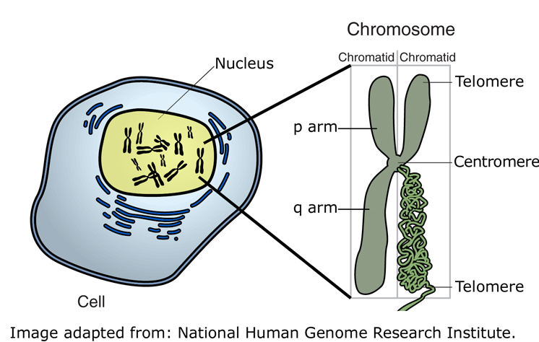
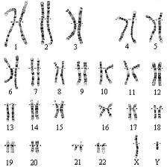
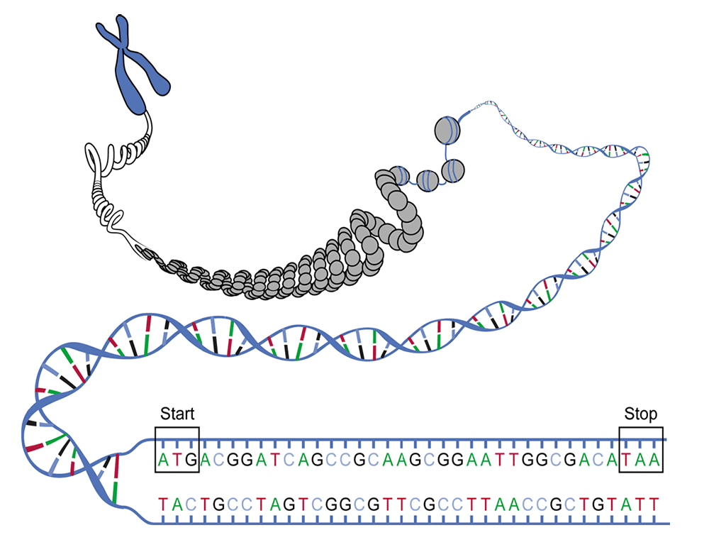
Basic concepts – Take notes
Cells
Chromosomes (ploidy)
DNA complementarity and strands
Variant site (SNPs are the most simple)
Genotype: homozygote / heterozygote
Haplotype

Slide 38
What is a gene?
Central Dogma
DNA
mRNA
Transcription
Protein
Translation
Codons, codon table and gene strand
There are large numbers of genes in multicellular organisms
Not all organism have multiple exons per gene and thus do not need splicing
Outside genes are regulatory elements that control when and where genes are expressed

Slide 39
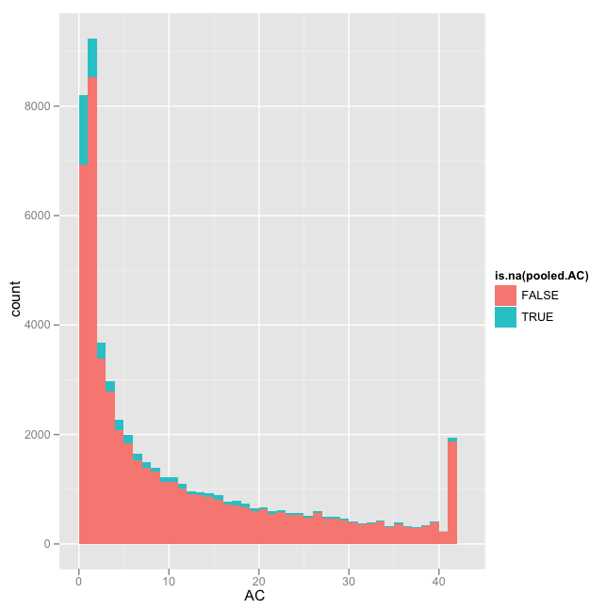
Distribution of Allele Count across 21 exomes
21 individual exomes (of diploid humans) i.e. 42 alleles

Slide 40
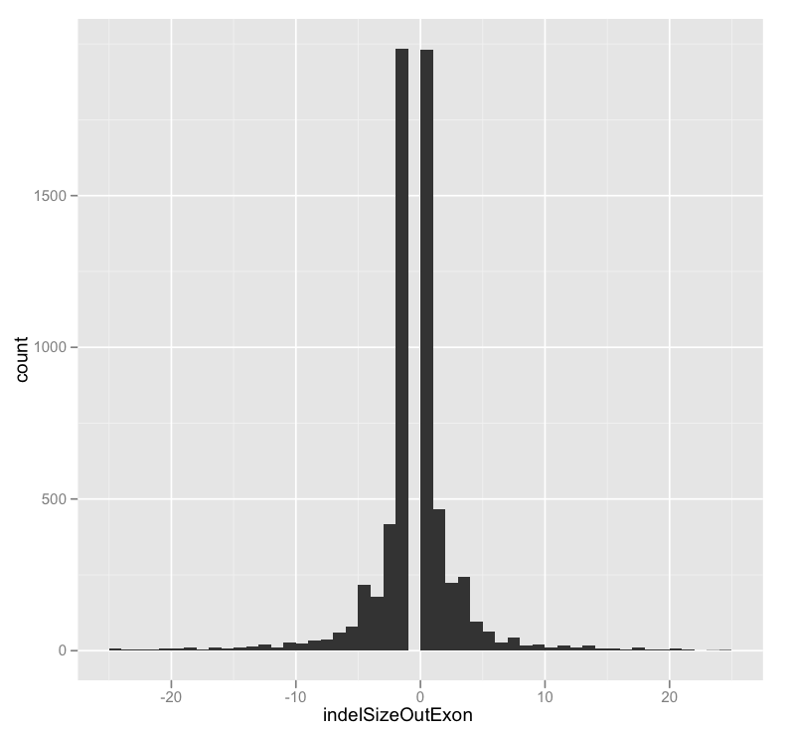
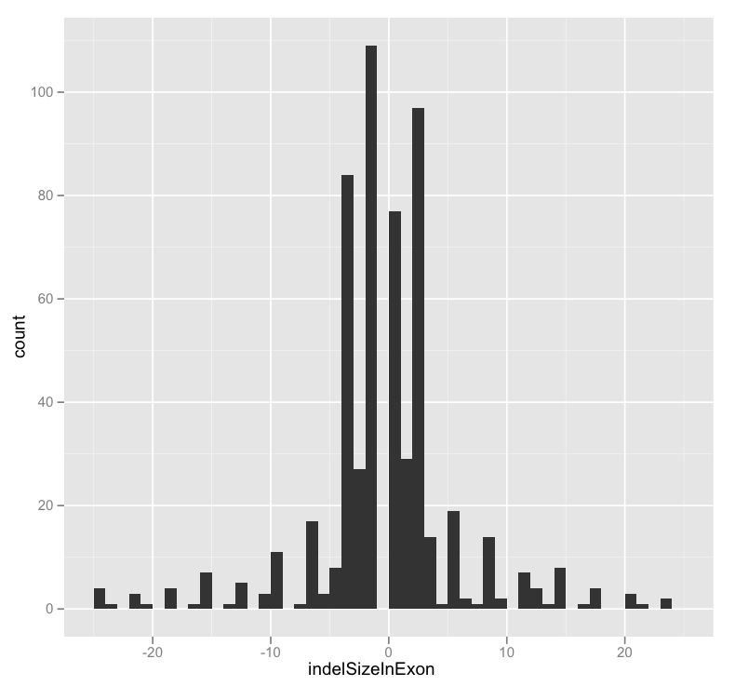
Make a note about indel size distribution
Sequencing of human exome
23,602 SNPs in coding exons (approx. 2.5M bp size)
40,621 SNPs outside coding exons (approx. 2.5M bp size)
Notice both numbers and pattern in indel figures

Slide 41
Mapping and alignment 101

Slide 42
Mapping
Read mapping is the process of locating where in the reference genome a read originates from
We typically have millions of 100-150 bp sequence reads which we need to map to a reference genome (often billions of bases)
In addition, there will often not be an exact match between the read and the reference due to:
base call errors in individual reads
variation in the sample relative to the reference.
One way of locating the origin of a read is to scan the whole genome looking for a match but this method is obviously very time consuming
later in the course we will study an algorithm which speeds this up

Slide 43
After mapping - Alignment
Ref A A A C A A T T A A G T
|
Sample AAAT
Sample A A A C A A A T A A T T A A G T
Ref A A A C - - - - A A T T A A G T
Sample A A A C A A A T A A T T A A G T
Correct alignment
Sample read A A A C A A A T A A T T
Ref A A A C - - - - A A T T A A G T
Sample read A A A C A A A T A A T T
Correct alignment
Ref A A A C A A T T A A G T
Sample read A A A C A A A T A A T T
Possible alignment

Slide 44
Alignment
Gap opening
Gap extension
With gap
Ref A A A C - - - - A A T T A A G T
Sample read A A A C A A A T A A T T
Wo gap
Ref A A A C A A T T A A G T
Sample read A A A C A A A T A A T T
Mismatch
Match
Key component of alignment algorithm is the scoring
negative contribution to score
opening a gap
extending a gap
mismatches
positive contribution to score
matches
The exact score contributions determine which alignment is chosen
Smith-Waterman is an algorithm for finding optimal alignment given a scoring scheme without exhaustively enumerating and scoring all possible alignments

Slide 45
EXOME CAPTURE – ESSENTIALS
Capture
Sequence
FASTQ
Mapping (BWA)
SAM
HouseKeeping & refinement
BAM
Variant calling (gatk)
VCF file

Slide 46
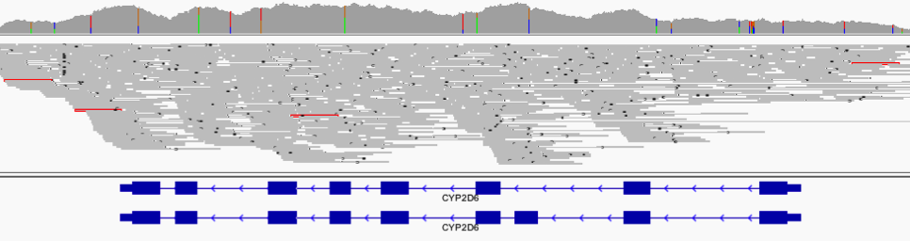
Sequencing a whole genome
We could sequence a whole genome BUT only a small fraction is actually genes
in human less than 2% of the genome codes for proteins
It saves a lot of sequencing to “capture” the regions we are interested in and sequence them

Slide 47
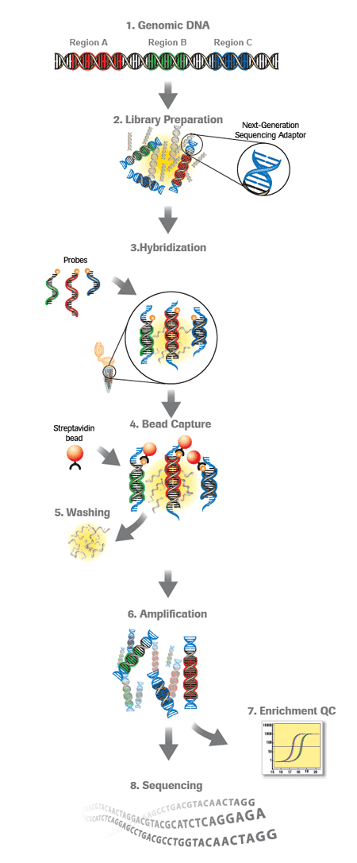
An overview of exome capture
Sonication
Library prep (sequencing adaptors on)
Oligonucleotide: AGCTAGATA
Sample DNA: ATCTATGATCT
Hybridisation to probes
Bead capture
Amplification
Sequencing

Slide 48
Practical 02 – calling variants in the blind
We look at the read datasets in local copy
Done together with instructor
Open script 020_basicPipeline.bash (this should be your own copy under ${HOME}/vc/exerDefinitions)
Explanation and execution of commands together with instructor

Slide 49
IGV mini practical
Open a new terminal and start IGV
Let us load up some data and explore some of the features of IGV
We will load two datasets:
The dataset that you generated in the previous exercise
${HOME}/vc/exerSandbox/02_basicPipeline
Another more realistic simulated dataset
${HOME}/vc/inputData/reads_agilentV1_chr5/simul_NA12878
Some the things we will do
loading files (locally or from server)
navigating (zoom in and out, back and forward)
getting access to details (on hover or click)
changing the way you view things (squish/expand, colours, pairs)
moving tracks and panels around and resizing
sessions
marking regions of interest
changing preferences like soft-clipped bases

Slide 50
Sequence – ESSENTIALS
Capture
Sequence
FASTQ
Mapping (BWA)
SAM
HouseKeeping & refinement
BAM
Variant calling (gatk)
VCF file

Slide 51
Sequencing
Here we will be assuming that sequencing was covered in a previous module of the course

Slide 52
Fastq format – ESSENTIALS
FASTQ
Mapping (BWA)
SAM
HouseKeeping & refinement
BAM
Variant calling (gatk)
VCF file

Slide 53
In a perfect world – Perfect sequencing
Perfect sequencing:
single molecule (no PCR)
full length
no deterioration of quality
While we are waiting:
Sanger
PCR
length: some kb
limited number of reads
high quality
HTS (Illumina)
PCR
100 bp PE
billions of reads
high quality, but deteriorating along read
full length
read
249 Mbp
chr
full length
read
few kbp
amplicon
100 bp
100 bp
read
300 bp
frag

Slide 54
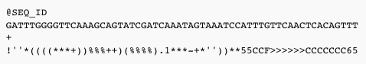
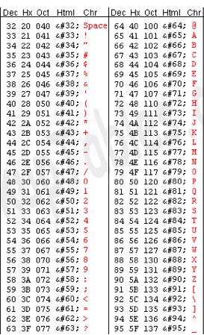
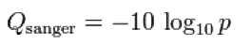
Fastq format – fasta with qualities
p = the probability that the corresponding base call is wrong
Qualities
p = 0.1 ➔ Q = 10
p = 0.01 ➔ Q = 20
P = 0.001 ➔ Q = 30
Encoding: Sanger/Phred format can encode a quality score from 0 to 93 using ASCII 33 to 126: Q + 33 ➔ ASCII code
Source: http://en.wikipedia.org/wiki/FASTQ_format

Slide 55
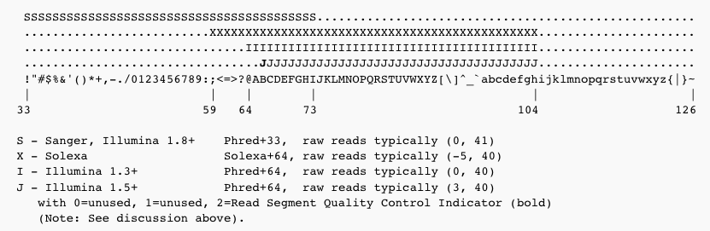
Different quality formulas and encodings
Beware of different versions
With sequence data recently produced, you do not need to worry
For older data, be careful
Tools such as BWA have an option for older formats

Slide 56
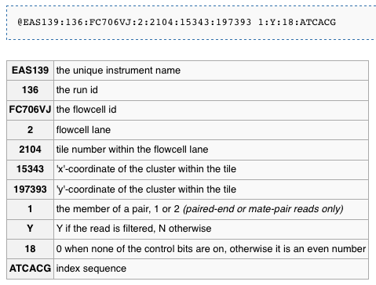
Illumina sequence identifiers

Slide 57
cleaning up fastq files (Not curriculum)

Slide 58
An overview of exome capture
Sonication
Library prep (sequencing adaptors on)
Problem: adaptor seq (red) in reads
Hybridisation to probes
Possible biases in sequences that hybridise
Bead capture
Possible biases in sequences that elute
Amplification
Possible biases in sequences that amplify
Sequencing
Possible biases in sequences that bridge PCR

Slide 59
The importance of clean up
Problem: adaptor seq in reads
There will be non-genomic sequences in reads
this will often prevent mapping
Consequences
if short fragments are randomly distributed >> less reads mapping >> reduced coverage >> not a big problem as long as the fraction of reads affected is not too large
if short fragments are not randomly distributed (e.g. Halo capture) >> specific areas will suffer from reduced/no coverage >> big problem
It all depends on the sample whether something really matters or not

Slide 60
Chip-seq example
If there are adaptors still attached to the genomic fragments in the material entering sequencing sample prep, the situation can be even more complicated.
Fastqc report is essential to get a feel for whether clean-up is required
Pre-sequencing sample prep
Partially successful removal of adaptors
Sequencing sample prep
Sequencing

Slide 61

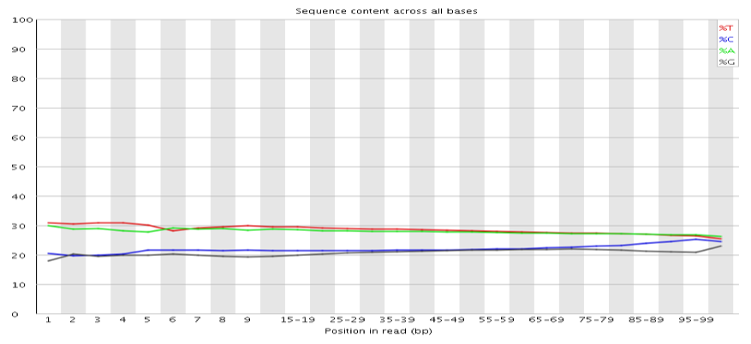
Per cycle sequence content
%
Position in read

Slide 62
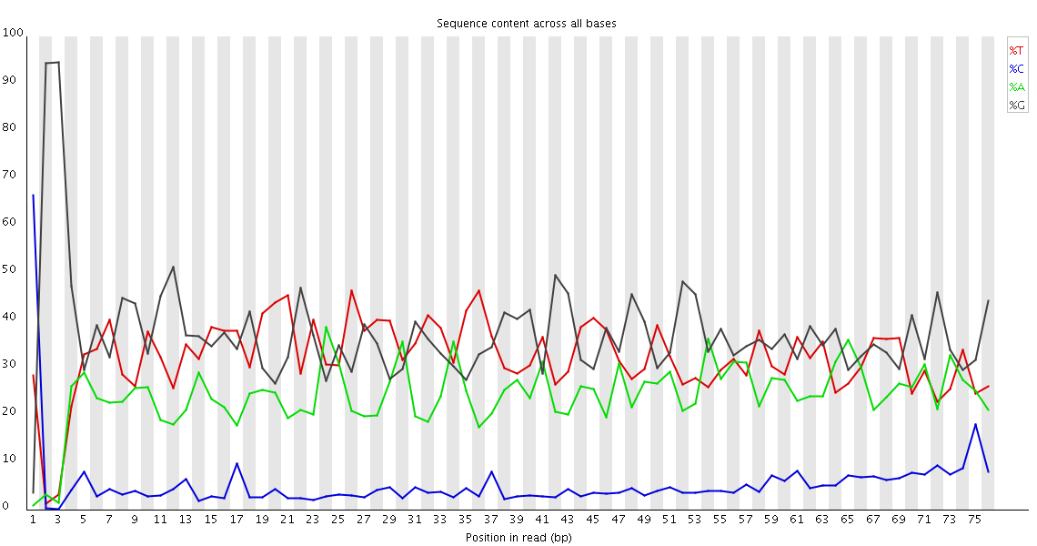

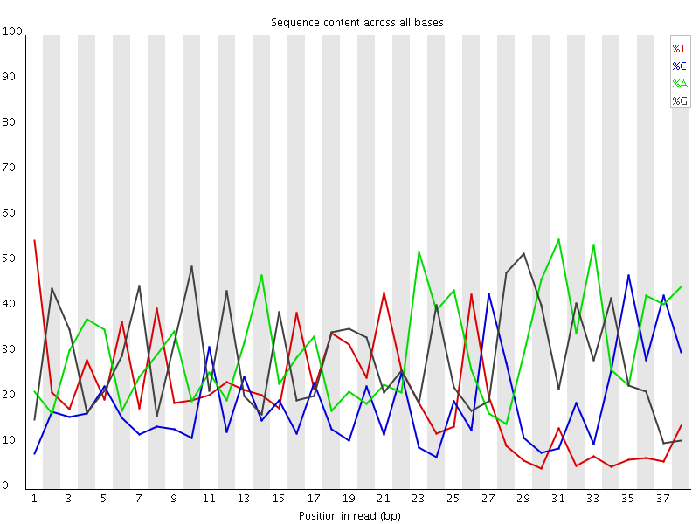
Per cycle sequence content

Slide 63
Manipulating fasta and fastq files
Fastx toolkit: http://hannonlab.cshl.edu/fastx_toolkit/
FASTQ trimmer
FASTQ quality filter
FASTQ quality trimmer
Can do most of the obvious manipulations of fastq/a you may need

Slide 64
How to perform clean up
Get an overview of the sample preparation both:
pre-sequencing
sequencing sample prep
Run fastqc on the data
pay particular attention to the base distribution results
Clean up using
fastx-toolkit
cutadapt
other tools
Remember that you need to synchronise the R1 and R2 files (with PE)
Reads from sequencer
Adaptors removed
Out of sync files
Read 1
Read 2
Read 1
Read 2
Read 1
Read 2
Read 1
Read 2
Synchronisation
Read 1
Read 2
NB: Synchronisation is very important even when not clipping off adaptors
(files can be unsynchronised for other reasons)

Slide 65
Mapping with BWA
FASTQ
Mapping (BWA)
SAM
HouseKeeping & refinement
BAM
Variant calling (gatk)
VCF file

Slide 66
Why mapping?
The biggest difference with Sanger
we did not design and use primers for sequence amplification
we sonicated
>> we do not know where the reads “originate” from
For each read
we need to determine its likely origin
how likely it is that we have correctly identified its origin

Slide 67
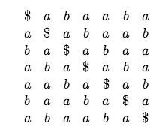
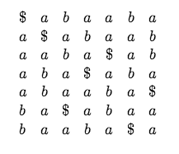
http://www.cs.jhu.edu/~langmea/resources/bwt_fm.pdf
The Burrows-Wheeler Transform (BWT) is a way of permuting the characters of a string T into another string BWT (T)
The permutation is reversible
For example for T = abaaba$
$ defined to be a cahracter that does not appear elsewhere in T and which is lexicographically prior to all other characters
The rotations of T
Burrows-Wheeler Matrix BW M(T)
Lexicographic sorting of rows
BWT(T)
BWT(T) = abba$aa

Slide 68
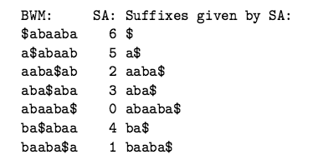
Relationship to suffix array
Suffix array = sorted array of all suffixes of a string
T = abaaba$
0 a b a a b a $
b a a b a $
a a b a $
a b a $
b a $
a $
$
6 $
5 a $
2 a a b a $
3 a b a $
0 a b a a b a $
4 b a $
1 b a a b a $
Correspond to the same ordering

Slide 69
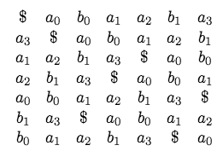
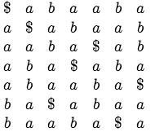
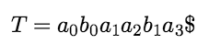
Reversing the BW transform
BWT(abaaba$) = abba$aa
Seem like we have lost which a in BWT(T) corresponds to which a in T
BUT we have not thanks to an important property of the BWT called LF mapping
The subscript corresponds to the number of times the character has previously been seen in T
We call the subscript the rank
$ does not require rank as occurs only once
The LF mapping states: the i^{th} occurrence of a character c in the last column has the same rank as the i^{th} occurrence of c in the last column
We will not prove why

Slide 70
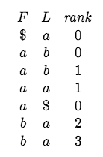
How do we reverse BWT?
We re-rank them:
* Before we ranked according how many times occurred previously in T ie T ranking
* Now we re-rank according to how many times previouly seen in BWT(T) ie B ranking
Rows are rotations of T so last col of the first row contains the chracted to left of $ in T: a
Start with $
Rank array tells us this is a with rank 0
How do we get the character to the left of a₀?
We can do this if we know the row that begins with a₀
The LF mapping states: the i^{th} occurrence of a character c in the last column has the same rank as the i^{th} occurrence of c in the last column
The LF tells us which row begins with a₀ : row 1
Assuming first row is 0, we visit rows: 0, 1, 5, 3, 2, 6, 4
Reversible means useful for compression

Slide 71
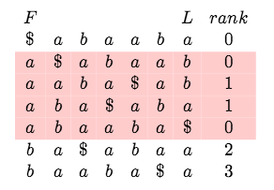
FM index – key to searching a string
Ferragina and Manzini: BWT can be used as a space-efficient index of T
Searching for occurrences of P = aba
The BWM is sorted, so any rows having P as a prefix will be consecutive
First find the rows beginning with the shortest suffix of P i.e. “a”
Second find all rows begin with the next longest suffix of P i.e. “ab” >> these are rows 1 and 2 (rows are rotations of T)
The LF mapping and rank array tell us which rows have “ba” as a prefix: row begining with b0 and b1

Slide 72
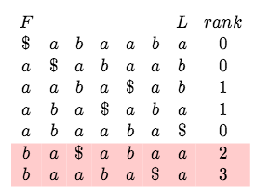
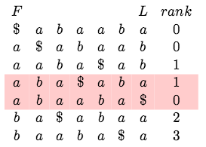
Searching T
The LF mapping and rank array tell us which rows have “ba” as a prefix: row begining with b0 and b1
Occurrences of “ba” are preceded by a2 and a3
Backward matching: apply LF mapping repeatedly to find range of rows prefixed by successively longer proper suffixes of P until range is empty or run out of suffixes

Slide 73
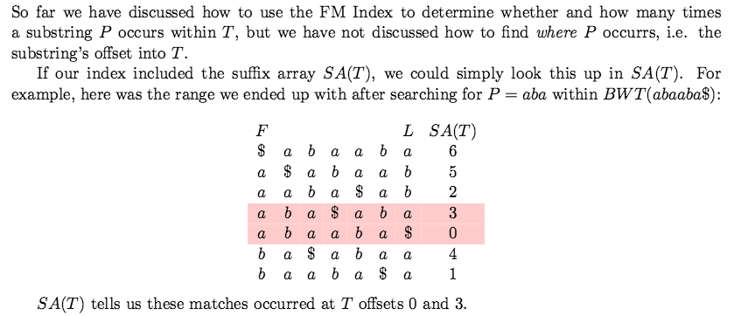
Looking up offsets
To understand the power of the BWT algorithm, you have to remember that we are searching for a short string (100 bp) in a very long string (3.0E09 bp).
There are many optimisation to:
Decrease space requirements
Decrease time requirements
Allow for mismatches

Slide 74
Application to read mapping
You need to build an index of the genome you wish to search
Reads are 100 bp long
But, the longer the string searched for the longer the search time (longer backtracking), thus an advantage to search with a shorter string.
There are 4 different nucleotides and 3.0E09 bases of genome
4**16 = 4.0E09
4**17 = 17.0E09
Assuming complex sequence, 16 to 17 bp should be enough for a unique match
BUT
variation in sample relative to reference
base call errors
THUS 17 bp search string is not enough
BWA searches with a “seed” of 32 and allows 2 differences in the seed
Reads with seed matches are aligned using Smith-Waterman

Slide 75
What are desirable characteristics of a read mapper?
Accurately predict the source of a read
in the normal range of base error rates
in the normal range of indel frequency and size
But, not necessary to get the alignment exactly right as this can be done later using multiple sequence alignment (MSA)
Produce an accurate estimate of the reliability of prediction
Reference
NNNNNCA_AGGNNN
Correct read align
NNNNNCAAAGNNNN
Reference
NNNNNCAAGNNNN
Sample
NNNNNCAAAGNNN
Reference
NNNNNCAAGGNNN
Alt. align
NNNNNCAAAGNNNN

Slide 76
Factors complicating mapping
The simple case
Complex sequence (100 bp)
Millions of reads
Billions of positions in human genome
Homologous regions
Base call error
Complex sequence (100 bp)
Risk of mismapping
gene 1A
gene 1B
Repetitive region
Repetitive sequence (100 bp)
Impossible to be map correctly
big repetitive region
Structural variation (not in reference)
Duplication in sample which is not present in the reference
Definite “mismapping”

Slide 77
Different programs
BWA
Novoalign
BOWTIE
SOAP
....
Most based on BWT: Burrows-Wheeler Transform
a very neat computer algorithm for finding the location of substrings within a string
can I find atgc in attgcatcgatcga.......
requires indexing of string / reference, but enables
rapid search, necessary when mapping billions of reads
manageable RAM footprint: 2.3 GB for single reads and 3GB for paired-end (for BWA), so runs on an ordinary computer

Slide 78
Mapping quality scores
The mapping quality score is the Phred-scaled probability of the mapping being incorrect.
Probability is computed from the qualities of the mismatched bases between read and reference and quality features of the second best hit (see Li, Ruan, and Durbin 2008)
All programs do not necessarily produce good estimates of mapping quality
BWA provides good mapping qualites with slight overestimation of quality score:
empirical error rate 7x10e-06 for Q60 mappings

Slide 79
BWA
Fast and accurate short read alignment with Burrows-Wheeler transform
Theoretically allows for differences and guarantees to find all intervals with x differences
But, in practice, makes changes to algorithm to adapt to biological reality and increase speed
different penalties for mismatches, gap open and extension
uses a seed approach: no more than x differences in the first 32bp of a read to increase speed
the alignment error rate (fraction of wrong alignments out of confident mappings in simulation) only marginally increases, but substantially improves speed
implementation modifications to speed up computation time
Paired-end mapping
Like similar programs, randomly places a repetitive read across the multiple equally best positions and mapping quality 0
Supports multi-threading (as do all BWT aligners)

Slide 80
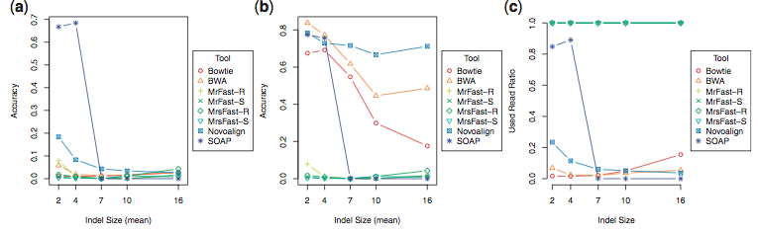
Accuracy with varying indel sizes
Accuracy
Accuracy
Used read ratio
BWA and Novoalign are best performing
Source: Ruffalo et al. 2011

Slide 81
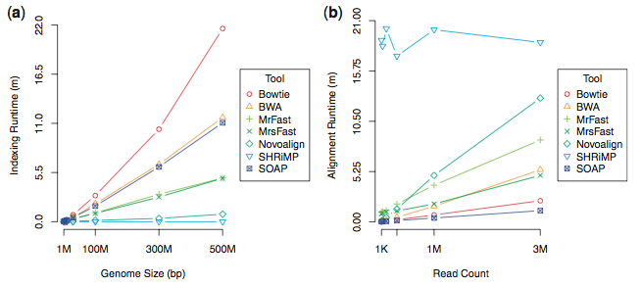
Runtime
500 MB genome
Source: Ruffalo et al. 2011

Slide 82
Words of caution about the comparison
Note this results are for SR 50 bp reads
reads are often longer with Illumina
can be much longer with other technologies and will require different mapper (see Fast and accurate long-read alignment with Burrows-Wheeler transform)
But, in summary:
mappers are not all of the same quality
bwa and novoalign are amongst the best

Slide 83
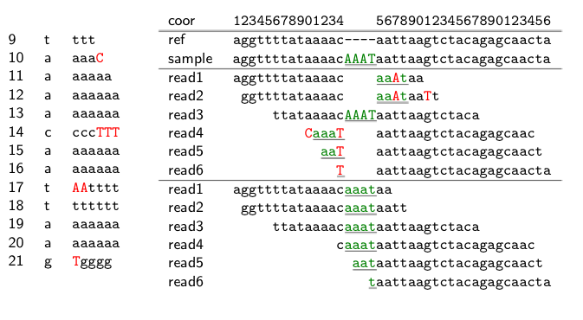
Alignment errors after mapping
Base stacks
Incorrect
Correct
>> Can be solved by alignment: considering all mapping reads and reference together (as we shall see later)
Source: Heng Li, presentation at GSA workshop 2011

Slide 84
SAM format
FASTQ
Mapping (BWA)
SAM
HouseKeeping & refinement
BAM
Variant calling (gatk)
VCF file

Slide 85
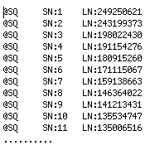
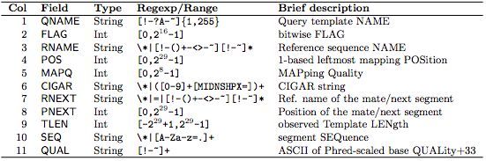
What does the SAM file look like?
Header
Data lines (one per read)
Source: The SAM format specification

Slide 86
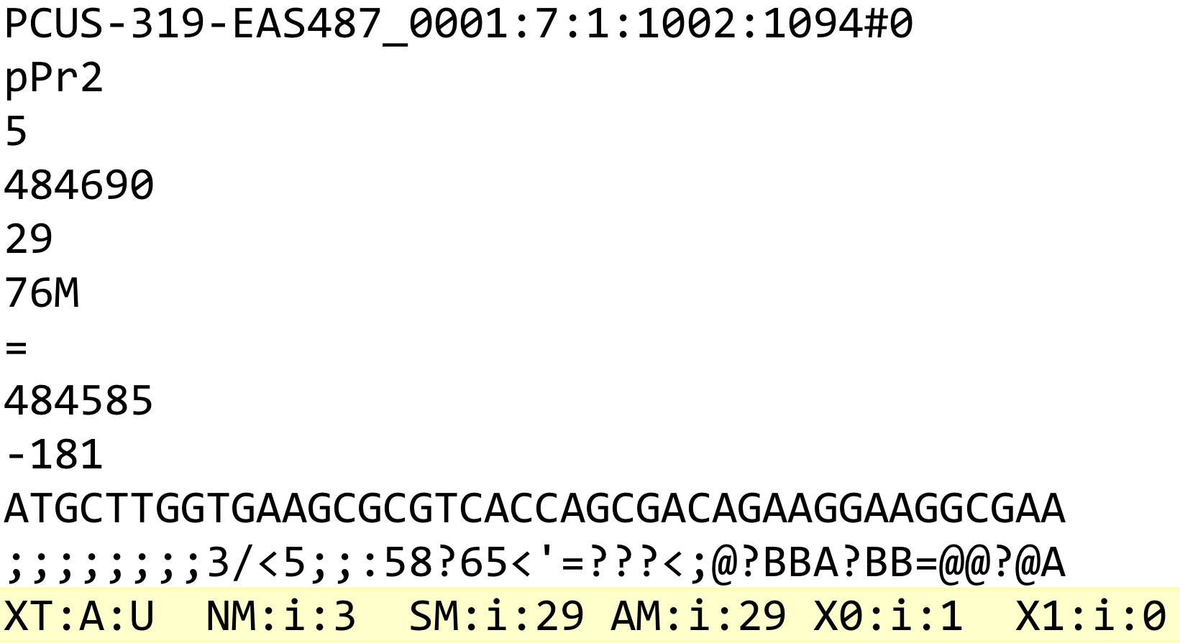
Inspecting one record

Slide 87
Difference between 1-based and 0-based coordinates
SAM (+ VCF and GFF) are 1-based
BED are 0-based
Can be very important when manipulating SNP coordinates >> be careful

Slide 88
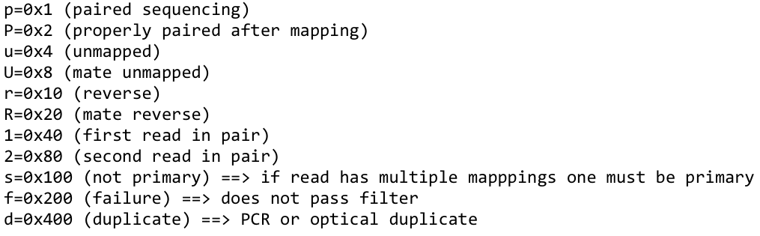
The FLAG column – a bit wise flag
100 bp
100 bp
read
300 bp
frag
Translate from bit wise flag to readable codes by using samtools view –X
OR take a look at https://broadinstitute.github.io/picard/explain-flags.html

Slide 89
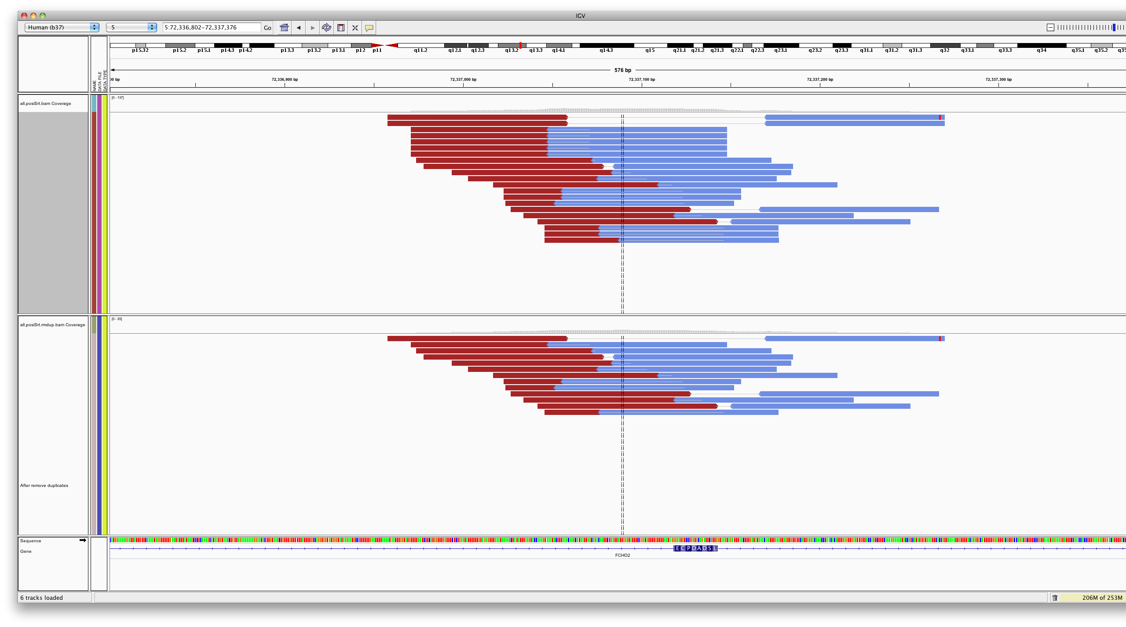
Introducing flags - What is a duplicate?

Slide 90
About the SAM file produced by BWA
It contains all the reads >> the Picard/GATK paradigm: information is annotated (and not filtered)
unique
ambiguous
unmapped
It has a number of short comings
it takes a lot of space ➔ convert to BAM
the mates are not fully updated on each others existence ➔ fixmate
it is not sorted ➔ sort
it contains PCR duplicates ➔ mark or remove duplicates
it does not contain meta-data on the reads (sample, sequencer, etc)

Slide 91
What tools can I use to manipulate the data?
Two alternative software packages for doing this
samtools
basic
easy to use
picard
advanced functionality
used by GATK team
For simple tasks like viewing, indexing, sorting ➔ samtools
For more advanced tasks and preparing for downstream analysis ➔ Picard due to GATKs pickyness
These tools will be introduced in more detail in the practicals
Brief practical: Take a look at your SAM file

Slide 92
Computing advanced metrics – picard
FASTQ
FASTQ
SAM
SAM
Sorted BAM
BAM
VCF file
Mapping (BWA)
VCF file
Mapping (BWA)
HouseKeeping (samtools)
HouseKeeping & refinement
Variant calling (bcftools)
Variant calling (gatk)

Slide 93
An overview of exome capture – weak points
Problem: error in sonication >> adaptor seq in reads >> unmapped reads
Sonication
Library prep (sequencing adaptors on)
Adapt
Fragment
Adapt
Adapt
Fragment
Adapt
Adapt
Fragment
Adapt
Hybridisation to probes
Possible biases in sequences that hybridise >> coverage bias
Bead capture
Possible biases in sequences that elute >> coverage bias
Amplification
Possible biases in sequences that amplify >> sequence PCR duplicates
Sequencing
Possible biases in sequences that bridge PCR >> coverage bias

Slide 94
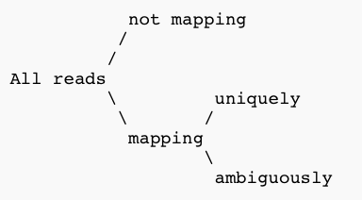
Metrics - Basic read classification
Contamination from other species
Reads containing non-genomic DNA e.g. adaptors
PCR gunk
Reads with sequencing errors
Parts of the genome that are not assembled
Parts of sample affected by structural variation
Complex sequence with sufficient length should map uniquely
Typical for repeats
Also possible for homologous regions

Slide 95
Metrics – Insert sizes

Slide 96
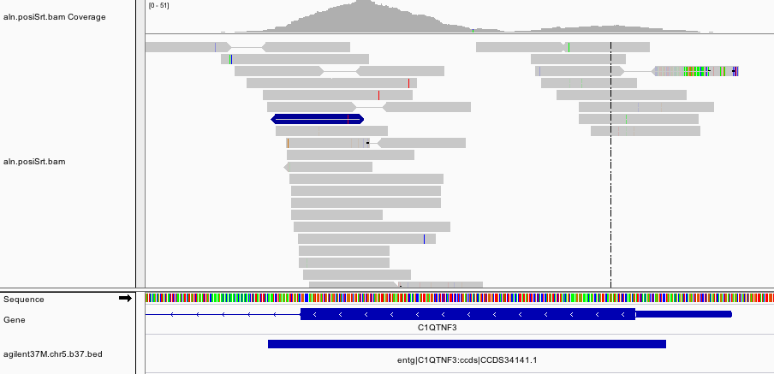
Metrics - Coverage
Even if doing Whole Genome Sequencing (WGS) >> coverage issues
due to repetitive regions
due to properties of the DNA e.g. GC content
Exome sequencing >> Capture by hybridisation
Coverage
Reads
Target
Tile

Slide 97
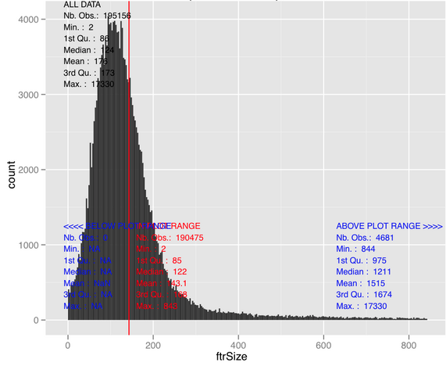

Exome capture – The nature of the target
CCDS exon length distribution

Slide 98


Coverage metrics – Effect of GC content

Slide 99
Duplicate metrics
Duplicates potentially introduce variant calling errors

Slide 100
021_generatingReports.bash
Time to see how we can do some of this in practice
Walk through the fastq and SAM/BAM part of the practical
Stop when we get to VCF part!
Walk through this together with instructor

Slide 101
VCF file - basics

Slide 102

VCF format
Meta data: definitions of tags used elsewhere in data lines
Header line
Data lines
Variant columns
Genotype columns
Source: The SAM format specification

Slide 103
Columns of data lines
CHROMO: chromosome / contig
POS: the reference position with the 1st base having position 1
ID: an id; rs number if dbSNP variant
REF: reference base.
The value in POS refers to the position of the first base in the string
for indels, the reference string must include the base before the event (and this must be reflected in POS)
ALT: comma sepearated list of alternate non-ref alleles called on at least one of the samples
if no alternate alleles then the missing value should be used “.”
QUAL: phred-scaled quality score of the assertion made in ALT (whether variant or non-variant)
FILTER: PASS if the position has passed all filters (defined in meta-data).
INFO: additional information
Source: The SAM format specification

Slide 104
REF and ALT
Reference
a t C g a >> C is reference base
a t G g a >> C is a G
a t – g a >> C is deleted
a t Cag a >> A is inserted
REF ALT
Variant
3 . C G
20 2 . TC T
20 3 . C CA
Variant
Variant
Source: The SAM format specification

Slide 105
REF and ALT
Reference
a t C g a >> C is reference base
a t G g a >> C is a G
a t – g a >> C is deleted
REF ALT
Variant
20 3 . C G
20 2 . TC T
Variant
REF ALT
To represent both in the same record
20 2 . TC T,TG

Slide 106
Comparing VCF files: normalisation
The VCF format is quite precise but still leaves room for representing one variant in multiple ways
VCF files need normalisation before comparison
Parsimony
Pos: 5, Ref: ATC, Alt: AT
Or Pos: 6, Ref: TC, Alt: T >> most parsimonious
Left alignment, suppose context: pos 8, ref: ATTTT, T deletion
Pos: 10, Ref: TT, Alt: T
Or Pos: 8, Ref: AT, Alt: A >> left aligned
MNP on separate lines
150 TCT CCC
Can be decomposed into two records: 150 T C AND 152 T C
One should also ensure that the same reference naming is used in both comparison files and that both files have the same sort order
More details at: https://github.com/chapmanb/bcbio.variation/wiki/Normalized-variant-representation and http://genome.sph.umich.edu/wiki/Variant_Normalization

Slide 107
021_generatingReports.bash (part II: VCF file)
Time to take a look at the VCF part of the practical
Do this together

Slide 108
Practical 022_workingWithFormats
introduction to manipulation of:
SAM/BAM
VCF
Walk through this together

Slide 109
APPENDIX

Slide 110
Overview of topics (not in chrono order)
Software and datasets setup and intro
Fastq format
Read mapping (SAM/BAM format)
IGV
Variant calling (VCF format)
Metrics reports (esp coverage – BED format)
Alignment refinement
Base quality score recalibration
Variant annotation and functional filtration

Slide 111
Comparison of different programs (optional)
Comparison analysis of algorithms for next-generation sequencing read alignment, Ruffalo et al. 2011
generate genome in silico with certain indel properties (size and frequency)
simulate reads from this genome with certain error rate
measure mapper accuracy: the true location of a read is considered the truth and a mapping is considered a prediction
What to look out for on the next slide
Ignore the Fast tools as they are poor mappers (green in legend)
Only focus on the parts of the plots that cover realistic range of parameters
In summary, BWA and Novoalign are both good mapping tools

Slide 112

Accuracy with varying error rate
With mapping quality threshold 10
Accuracy
Accuracy
Used read ratio
No indels
Higher range of error rate is unrealistic
Minor differences between good algorithms in range
Source: Ruffalo et al. 2011

Slide 113

Accuracy with varying indel frequency
With mapping quality threshold 10
Accuracy
Accuracy
Used read ratio
indel size fixed at 2 ➔ small
error rate fixed at 0.01 ➔ somewhat high
only lower indel frequencies are realistic ➔ small differences between programs in relevant range
soap would have looked a lot worse if indel size had been bigger
Source: Ruffalo et al. 2011

